Slide 1
Intro to Machine Learning – week 6

Slide 2
Today’s class
Resampling methods
Cross Validation
Bootstrap
Review

Slide 3
What is Resampling?
A process of selecting new subsets of the training data and fitting the model to each set
Allows us to examine how model errors change when our training sample is different
Allows us to compare varying levels of model flexibility to find an optimal level
Allows us to compare varying levels of tuning parameters (from SVM: C and gamma)
General method that can applied to any predictive machine learning technique

Slide 4
Cross-validation
Helpful for model assessment and model selection
In its simplest form, this is the training/testing data split we’ve been discussing throughout the class
We compare the testing error rate of new input data with the training error rate
There are many approaches
Leave-One-Out Cross-Validation (LOOCV)
k-fold Cross-Validation

Slide 5
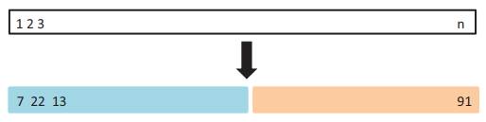
Validation set approach
Very simple strategy – we’ve been discussing it already
Randomly divide the entire labeled data set into a training and “validation” split.

Slide 6
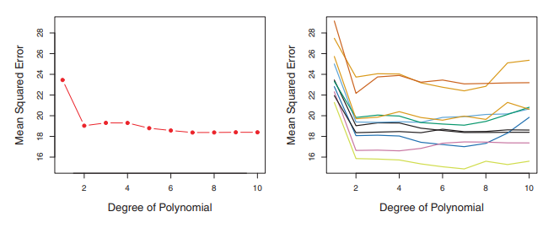
Validation set approach
Left: Validation estimates for single split
Right: Validation estimates for ten splits

Slide 7
Validation set approach
Quadratic component for model shows big improvement for every split
There is no consistent advantage to adding higher order terms

Slide 8
Validation set drawbacks
Validation estimate of the test error rate can be highly variable depending on which observations are in training / validation
Only a subset of training data is used to fit the model. Statistical methods tend to perform worse with less training observations. This means the validation set error might overestimate the test error rate.
Other Cross-Validation methods help solve these issues

Slide 9
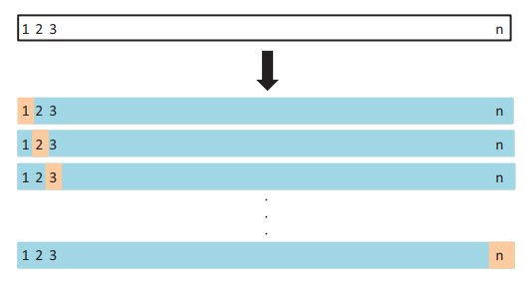
LOOCV approach
“Leave one out” cross validation
Split observations into two parts:
N – 1 observations training data set
1 observations validation data set

Slide 10
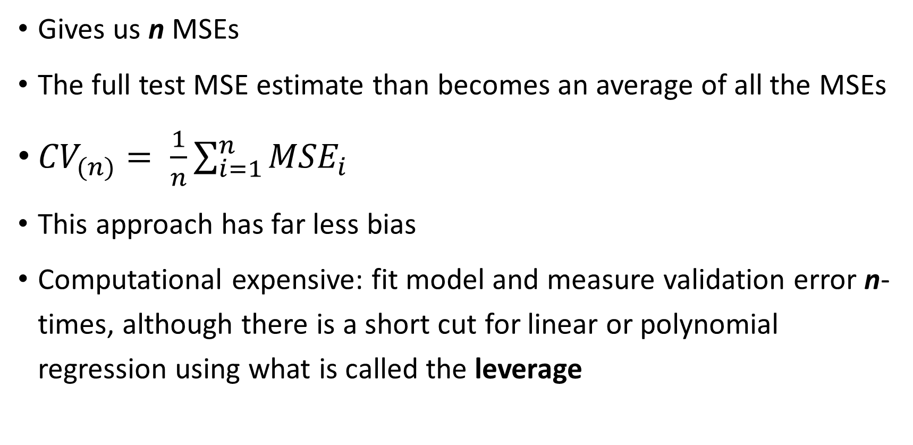
LOOCV approach
Gives us n MSEs
The full test MSE estimate than becomes an average of all the MSEs
${CV}_{(n)}= \frac{1}{n}\sum_{i=1}^{n}{{MSE}_{i}}$
This approach has far less bias
Computational expensive: fit model and measure validation error n-times, although there is a short cut for linear or polynomial regression using what is called the leverage

Slide 11
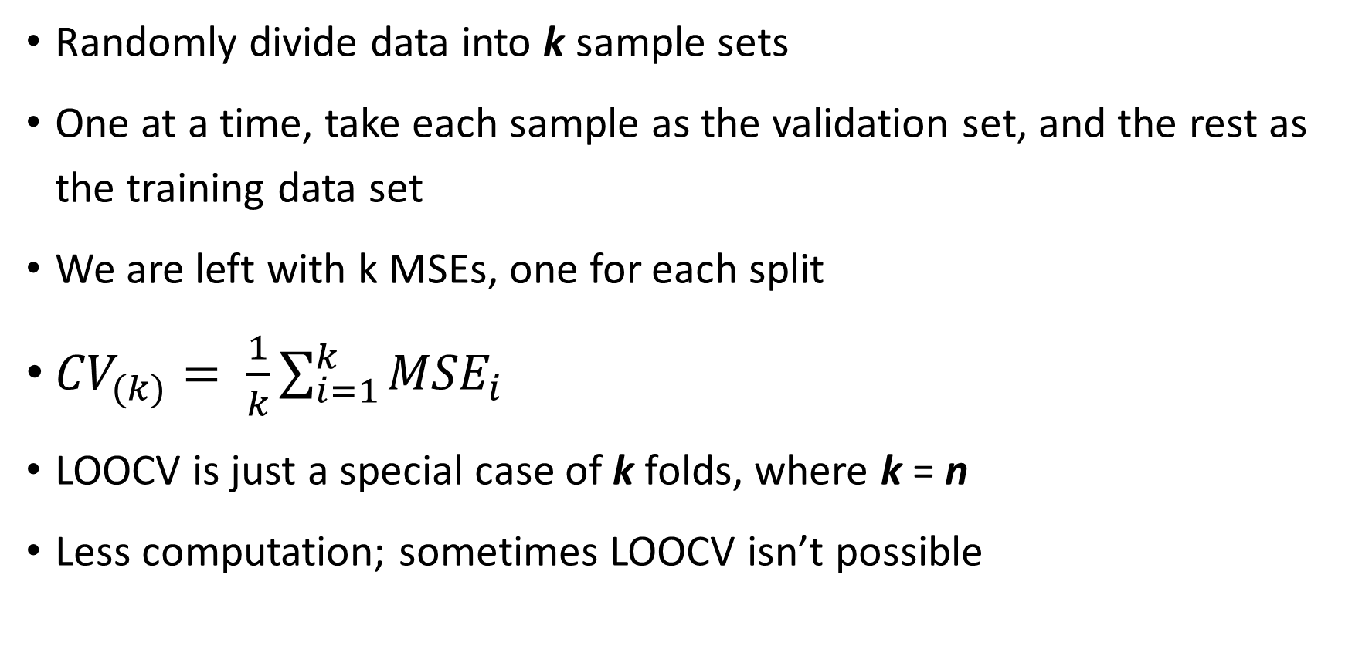
K-folds cross validation approach
Randomly divide data into k sample sets
One at a time, take each sample as the validation set, and the rest as the training data set
We are left with k MSEs, one for each split
${CV}_{(k)}= \frac{1}{k}\sum_{i=1}^{k}{{MSE}_{i}}$
LOOCV is just a special case of k folds, where k = n
Less computation; sometimes LOOCV isn’t possible

Slide 12
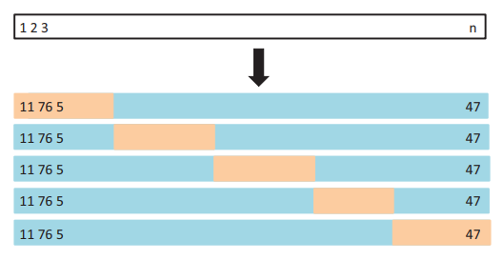
K-folds cross validation approach

Slide 13
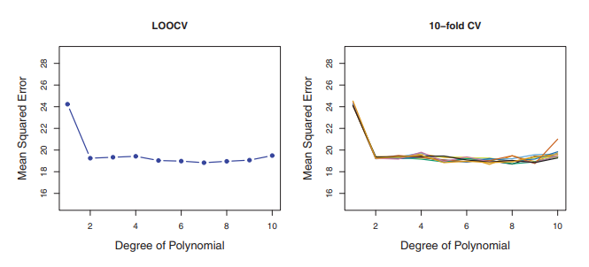
K-folds cross validation approach

Slide 14
Bias – variance trade off of k-folds
Aside from computational advantage of k-folds CV, a potentially more important advantage is that it often gives more accurate estimates of the test error rate
LOOCV has higher out-of-sample variance
This is because each model in LOOCV is essentially trained on the same set of data (with the difference of one observation)
The outputs from LOOCV are highly correlated with each other
With k-folds, the similarities between each training set is much less, so we get a better idea of how the model will perform given a new, unique, set of data

Slide 15
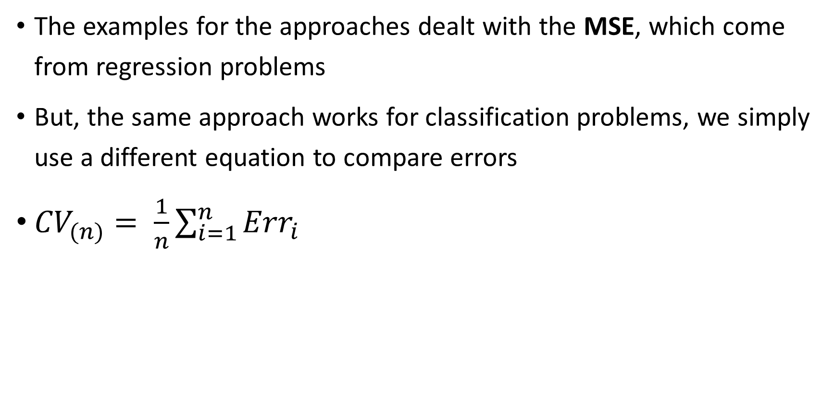
Cross validation – classification
The examples for the approaches dealt with the MSE, which come from regression problems
But, the same approach works for classification problems, we simply use a different equation to compare errors
${CV}_{(n)}= \frac{1}{n}\sum_{i=1}^{n}{{Err}_{i}}$

Slide 16
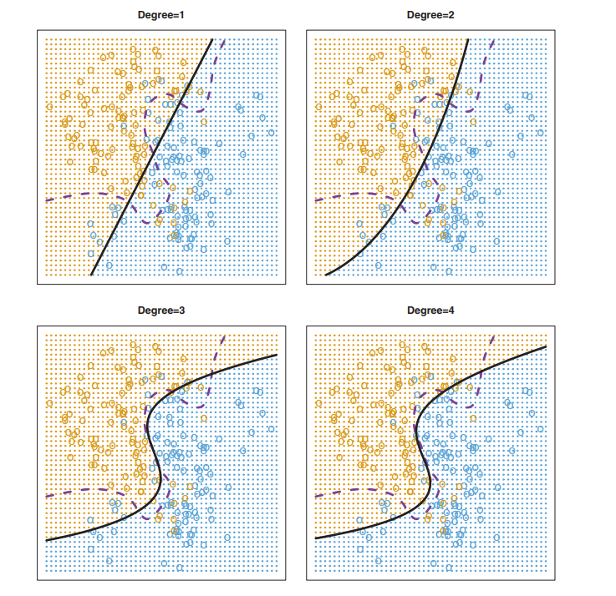
Cross validation – classification
Logistic Regression Test Error Rates:
0.201
0.197
0.160
0.162
Population Bayes Test Error:
0.133

Slide 17
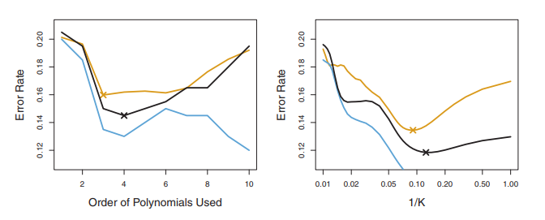
Cross validation – classification
Blue: Training Error
Black: 10-fold CV Error
Brown: Test Error

Slide 18
The bootstrap
The bootstrap is very powerful tool that can quantify the uncertainty of any estimator
It relies on random sampling with replacement of the data to build many versions of the estimator in question, then looking at the variance of those estimators
Since it’s with replacement, the same observation has potential to show up in our subset more than once

Slide 19
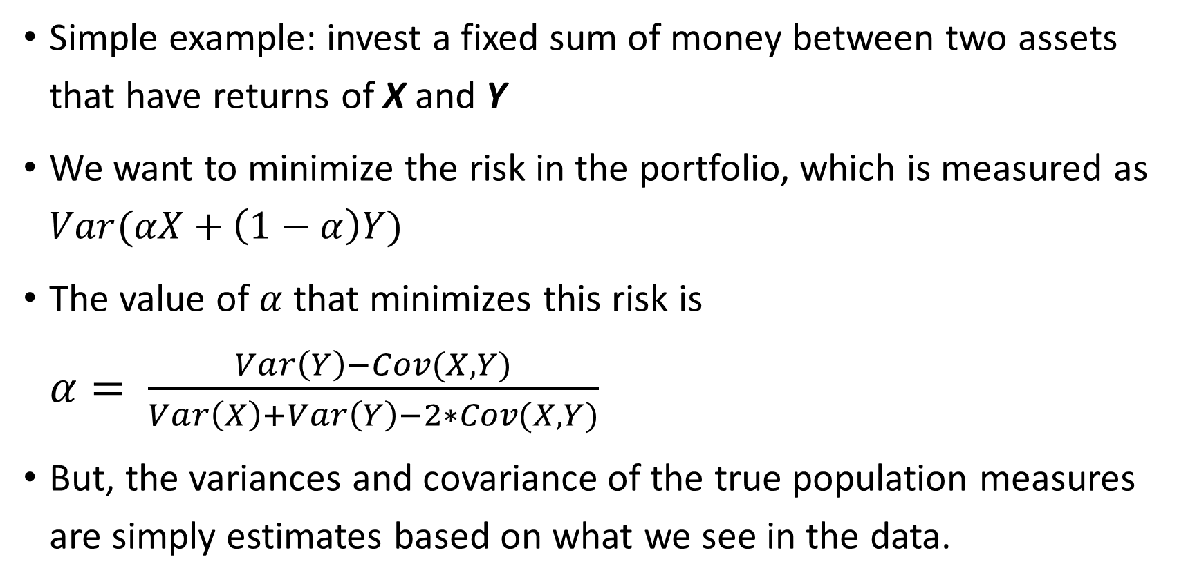
The bootstrap
Simple example: invest a fixed sum of money between two assets that have returns of X and Y
We want to minimize the risk in the portfolio, which is measured as $Var(αX+\left(1−α\right)Y)$
The value of $α$ that minimizes this risk is $α= \frac{Var\left(Y\right)−Cov(X,Y)}{Var\left(X\right)+Var\left(Y\right)−2∗Cov(X,Y)}$
But, the variances and covariance of the true population measures are simply estimates based on what we see in the data.

Slide 20
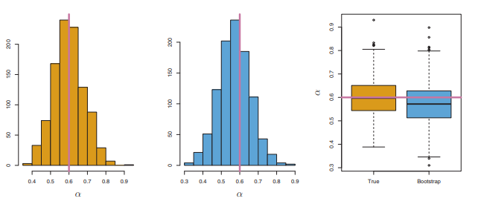

The bootstrap
If we estimate $α$ 1,000 times on random observations of X and Y, we can get a better idea of the variance of our estimator

Slide 21
Cross validation versus the bootstrap
They might seem similar, but are actually very different techniques for different purposes
CV is used to estimate the test, or “out-of-sample”, error. This gives us clues as to what to expect within reason when we are given new input data, and also helps us pick the right model by avoiding overfitting
Bootstrap is used to measure the accuracy, or variance, of an estimator, and how far off it might reasonable be from the true population estimator
Technically, you could use the bootstrap method (sampling with replacement thousands of times) as your cross validation method of partitioning the data

Slide 22
Final thoughts
Cross validation
Used to pick an appropriate model and level of flexibility
Uses all data points
Validates model performance
Bootstrap
Used to quantify any uncertainty about the model you selected via cross-validation
Resamples data randomly, might not hit all observations

Slide 23
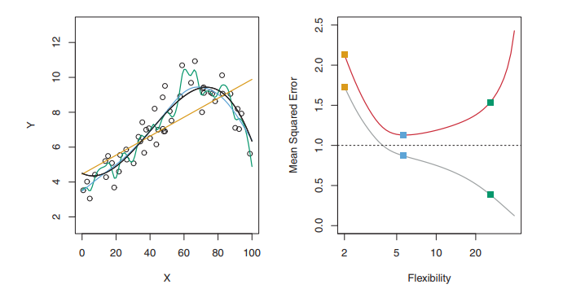
REVIEW
As model flexibility increases, what happens to the training and test MSEs?
The training MSE tends to always decrease as we over-fit the model. Because of this eventual over-fitting, the test MSE follows a U-shaped curve

Slide 24
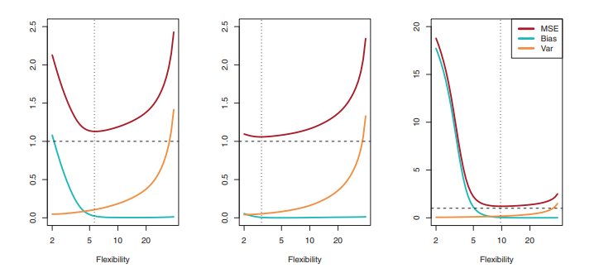
REVIEW
In general, as model flexibility increases, what happens to the test MSE? What two competing sources of error cause this behavior, and how do they behave?
Test MSE tends to follow a U shaped curve, due to bias and variance. Bias drops with flexibility, but variance increases with flexibility was the model over-fits the training data

Slide 25
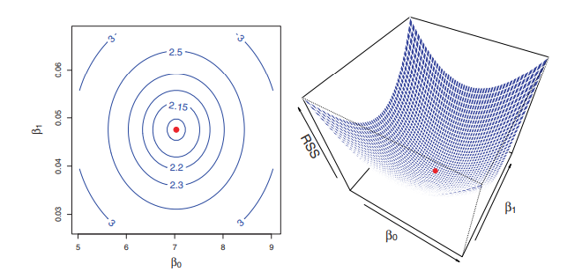

REVIEW
For linear regression, what is the cost function that the algorithm tries to minimize the find the appropriate beta coefficients?
The Residual Sum of Squares
$e_{i}= y_{i} − {\hat{y}}_{i}$
$RSS= e_{1}^{2}+ e_{2}^{2}+ …+ e_{n}^{2}$

Slide 26
REVIEW
What are some ways to select important input variables for your model?
Fit a simple linear regression model to each variable, and pick the one with the most significance. Continue to add variables until you are satisfied (forward selection). Fit a model to all variables and prune least significant variables until all are significant and model is assessed at a high level (backward selection). Backward selection cannot be used if p > n

Slide 27
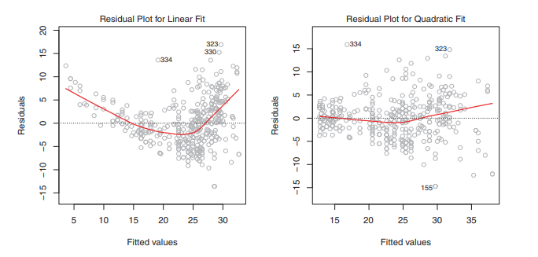
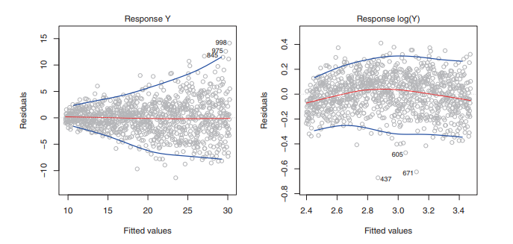
REVIEW
What is a residual plot and how can it help us discover problems with our model?
A residual plot shows the model errors versus either a predictor or the response. It helps to reveal non-linearity and non-constant variance of error terms

Slide 28
REVIEW
What is multicollinearity? How should we deal with it?
When two or more predictors are highly correlated (breaking our independence assumption)
Remove highly correlated predictors from the model
Use Principal Component Analysis to collapse predictors into independent and transformed predictors
Use Ridge Regression or Lasso to penalize coefficients that support correlated variables
Use Elastic Net to group correlated variables together

Slide 29
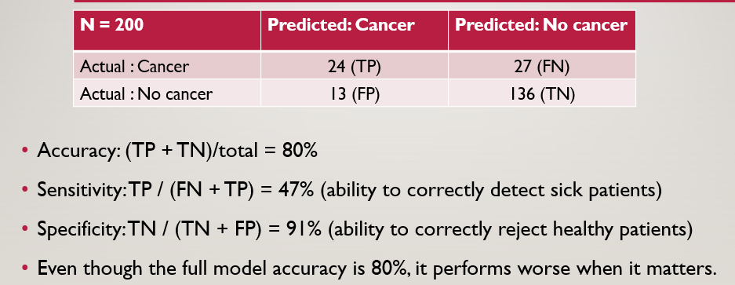
REVIEW
In classification, what are sensitivity (recall) and specificity?
Sensitivity: if a person has a disease, how often will a test for the disease be positive (true positive rate)? TP / (TP + FN)
Specificity: If a person does not have the disease, how often will the test be negative (true negative rate)? TP / (TN + FP)

